Slide 1
Credit Card Fraud Detection

Slide 2
Credit Card Fraud Detection
Since online shopping is on the rise there is an unfortunate increase in credit card fraud. It is important that credit card companies are able to recognize fraudulent credit card transactions so that customers are not charged for items that they did not purchase. Fraud is the issue we have here and we’re trying to build a system that will predict the fraud and stop the transaction
With global credit card fraud loss on the rise, it is important for banks, as well as e-commerce companies, to be able to detect fraudulent transactions (before they are completed).

Slide 3
Fraud Detection Approach:
We can deal with the problem of fraud detection by using classic machine learning. We can train a machine learning model. All supervised machine learning algorithms for classification problems work here, e.g., random forest, logistic regression, etc.

Slide 4
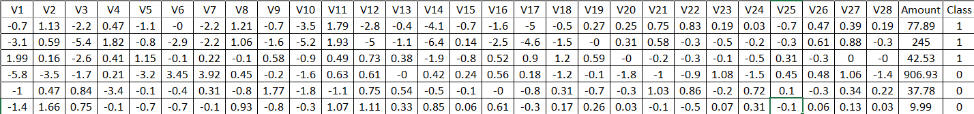
Dataset:
The dataset was obtained from Kaggle and it contains transactions made by credit cards in September 2013 by European cardholders
This dataset presents transactions that occurred in two days, where we have 492 frauds out of 9541 transactions
9541 datapoints and 30 features, all datapoints are numerical

Slide 5
Dataset:
Class: represent fraud occurrence
1=fraudulent
0=ok transaction
Amount: represent the transaction amount
(v1-v28) the col names are hidden to protect user identities and sensitive features

Slide 6
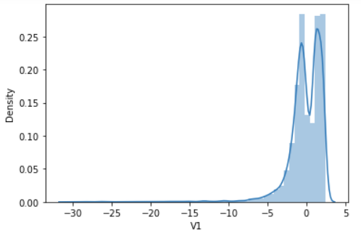
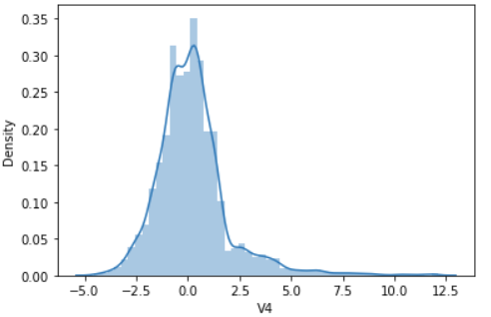
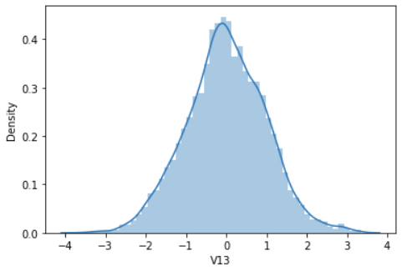
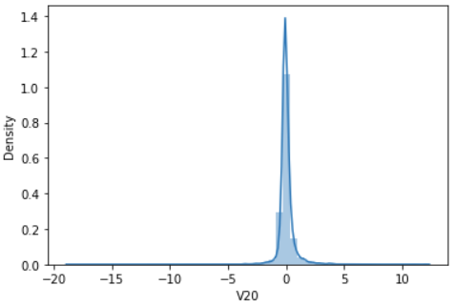
Distribution of variables:

Slide 7
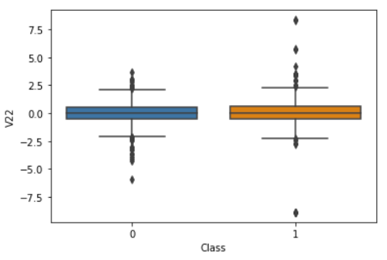
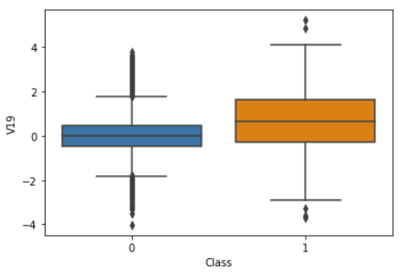
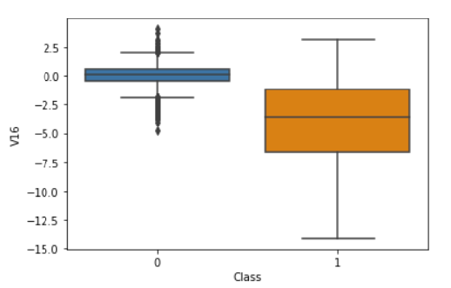
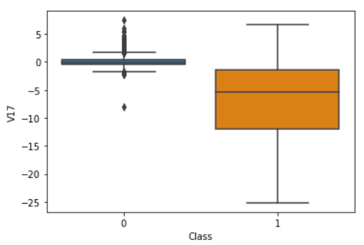
Correlations:

Slide 8
Modeling:
By using logistic regression we will predict the fraudulent transactions
Logistic regression is a mathematical model used in statistics to estimate the probability of an event occurring having been given some previous data.
Train_score: 99.2%
Test_score: 98.9%

Slide 9
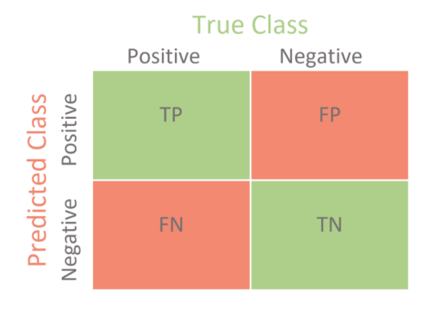
Confusion Matrix:
936
0
11
57

